Slide 1
Task 7: Domain Model and Sequence Diagram

Slide 2
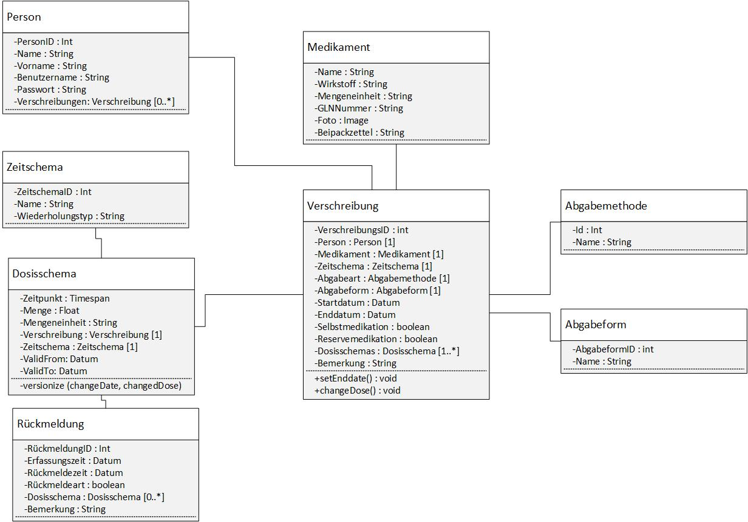
Class Diagram

Slide 3
Sequence Diagram «Alert»

Slide 4
Sequence Diagram «Update»

